Slide 1
mathematical optimization
CO2- Integer programming

Slide 2





AIM OF THE SESSION
To familiarize students with the concept of Integer Programming.
INSTRUCTIONAL OBJECTIVES
This Session is designed to:
Introduce Integer linear programming (ILP)
Introduce types of ILP
Discuss methods to solve ILP
LEARNING OUTCOMES
At the end of this session, the students should be able to:
Understand ILP

Slide 3
INTEGER PROGRAMMING: AN INTRODUCTION
An integer programming model is one where one or more of the decision variables has to take on an integer value in the final solution
Solving an integer programming problem is much more difficult than solving an LP problem
Even the fastest computers can take an excessively long time to solve big integer programming problems
If requiring integer values is the only way in which a problem deviates from a linear programming formulation, then it is an integer programming (IP) problem. (The more complete name is integer linear programming, but the adjective linear normally is dropped except when this problem is contrasted with the more esoteric integer nonlinear programming problem
So, The mathematical model for integer programming is the linear programming model with the one additional restriction that the variables must have integer values

Slide 4
TYPES OF INTEGER PROGRAMMING
PROBLEMS
PURE-INTEGER PROBLEMS
  require that all decision variables have integer solutions.
MIXED-INTEGER PROBLEMS
  Require some, but not all, of the decision variables to have integer values in the final solution, whereas others need not have integer values.
0–1 INTEGER PROBLEMS
  Require integer variables to have value of 0 or 1, such as situations in which decision variables are of the yes- no type.

Slide 5
INTEGER PROGRAMMING:
FORMULATION
Pure ILP Problem:
A jewelery shop in the city specializes in ornaments and the manger has planned to limit the use of diamonds to the artistic configuration of diamond rings, diamond earnings and diamond necklaces. The three items require the following specifications:
ORNAMENT DIAMOND
 | ½ Carat | ¼ Carat
Ring | 4 | 6
Earring (Pair) | 3 | 5
Necklace | 10 | 9
Availability | 150 | 160
The jeweler does no want to configure the diamond into more than 50 items. The per unit profit for the rings is Rs. 1500, for earnings is Rs. 2400 and for necklace is Rs. 3600. Formulate the problem as an ILP model for maximizing the profit.

Slide 6
INTEGER PROGRAMMING:
FORMULATION
Decision Variables: Let X₁ = Number of diamond rings,
X₂= Number of pair of earrings, X₃ = Number of necklaces
Objective Function: Max. Z = 1500X₁ + 2400X₂ + 3600X₃
Subject to:
4X₁ + 3X₂ + 10X₃ ≤ 150 (1/2 Carat Diamond)
6X₁ + 5X₂ + 9X₃ ≤ 160 (1/4 Carat Diamond)
X₁ + X₂ + X₃ ≤ 50 (Total Number of items) With X₁, X₂, X₃ ≥ 0;
X₁, X₂, X₃ are integers

Slide 7
INTEGER PROGRAMMING:
FORMULATION
Pure ILP Problem:
Northeastern Airlines is considering the purchase of new long-, medium-, and short- range jet passenger airplanes. The purchase price would be $67 million for each long- range plane, $50 million for each medium-range plane, and $35 million for each short- range plane.
The board of directors has authorized a maximum commitment of $1.5 billion for these purchases. Regardless of which airplanes are purchased, air travel of all distances is expected to be sufficiently large that these planes would be utilized at essentially maximum capacity. It is estimated that the net annual profit (after capital recovery costs are subtracted) would be $4.2 million per long-range plane, $3 million per medium-range plane, and $2.3 million per short-range plane.
It is predicted that enough trained pilots will be available to the company to crew 30 new airplanes. If only short-range planes were purchased, the maintenance facilities would be able to handle 40 new planes. However, each medium-range plane is equivalent to 4/3 short-range planes, and each long-range plane is equivalent to 5/3 short-range planes in terms of their use of the maintenance facilities.
The information given here was obtained by a preliminary analysis of the problem. A more detailed analysis will be conducted subsequently. However, using the preceding data as a first approximation, management wishes to know how many planes of each type should be purchased to maximize profit. Formulate an IP model for this problem.

Slide 8
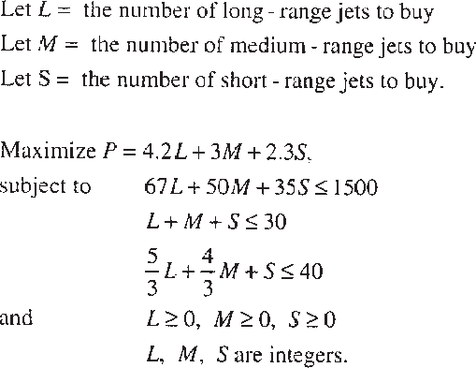
INTEGER PROGRAMMING:
FORMULATION

Slide 9
INTEGER PROGRAMMING:
FORMULATION
Mixed ILP Problem:
A textile company can use any or all of three different processes for weaving in standard white polyester fabric. Each of these production processes has a weaving machine setup cost and per square-meter processing cost. These costs and the capacities of each of the three production processes are shown below:
Process Number | Weaving machine Set –Up cost (Rs.) | Processing Cost (Rs.) | Maximum daily capacity (Sq. meter)
1 | 150 | 15 | 2000
2 | 240 | 10 | 3000
3 | 300 | 8 | 3500
The daily demand forecasts for its white polyester fabric is 4000 Sq. meter. The company’s production manager wants to determine the optimal combination of the production processes and their actual daily production levels such that the total production cost is minimized.

Slide 10
INTEGER PROGRAMMING:
FORMULATION
Decision Variables: Let X_{j} be the production level for process j (j = 1, 2, 3) also let
  Y_{j} = 1 if process j is used, and
  Y_{j} = 0 if process j is not used
Objective Function:
  Minimize Z = (15X₁ + 10X₂ + 8X₃) + (150Y₁ + 240Y₂ + 300Y₃ )
Subject to:
X₁ + X₂ + X₃ = 4000 (Daily Diamond)
X₁ – 2000Y₁ ≤ 0 (Daily Capacity of Process-1)
X₂ – 3000Y₂ ≤ 0 (Daily Capacity of Process-2)
X₃ – 3500Y₃ ≤ 0 (Daily Capacity of Process-3)
With X₁, X₂, X₃ ≥ 0; Y_{j} = 0 or 1, j= 1, 2, 3

Slide 11
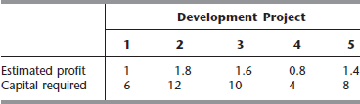
INTEGER PROGRAMMING:
FORMULATION
Zero–One ILP Problem:
A real estate development firm, Peterson and Johnson, is considering five possible development projects. The following table shows the estimated long- run profit (net present value) that each project would generate, as well as the amount of investment required to undertake the project, in units of millions of dollars.
The owners of the firm, Dave Peterson and Ron Johnson, have raised $20 million of investment capital for these projects. Dave and Ron now want to select the combination of projects that will maximize their total estimated long-run profit (net present value) without investing more that $20 million. Formulate a Binary Integer Programming (0–1) model for this problem.

Slide 12
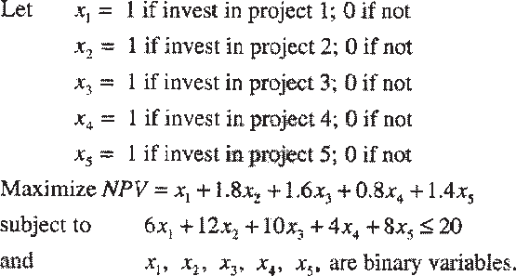
INTEGER PROGRAMMING:
FORMULATION

Slide 13
SELF-ASSESSMENT QUESTIONS
Pure ILP can have
A)All the decision variables has to have integer solutions
B) At least one decision variables has to have integer solutions
C) Both
D) none of the above
Types of ILP are
Pure
Mixed
0-1
All
Notes:
Answer 1 b and 2 c
13

